Slide 1
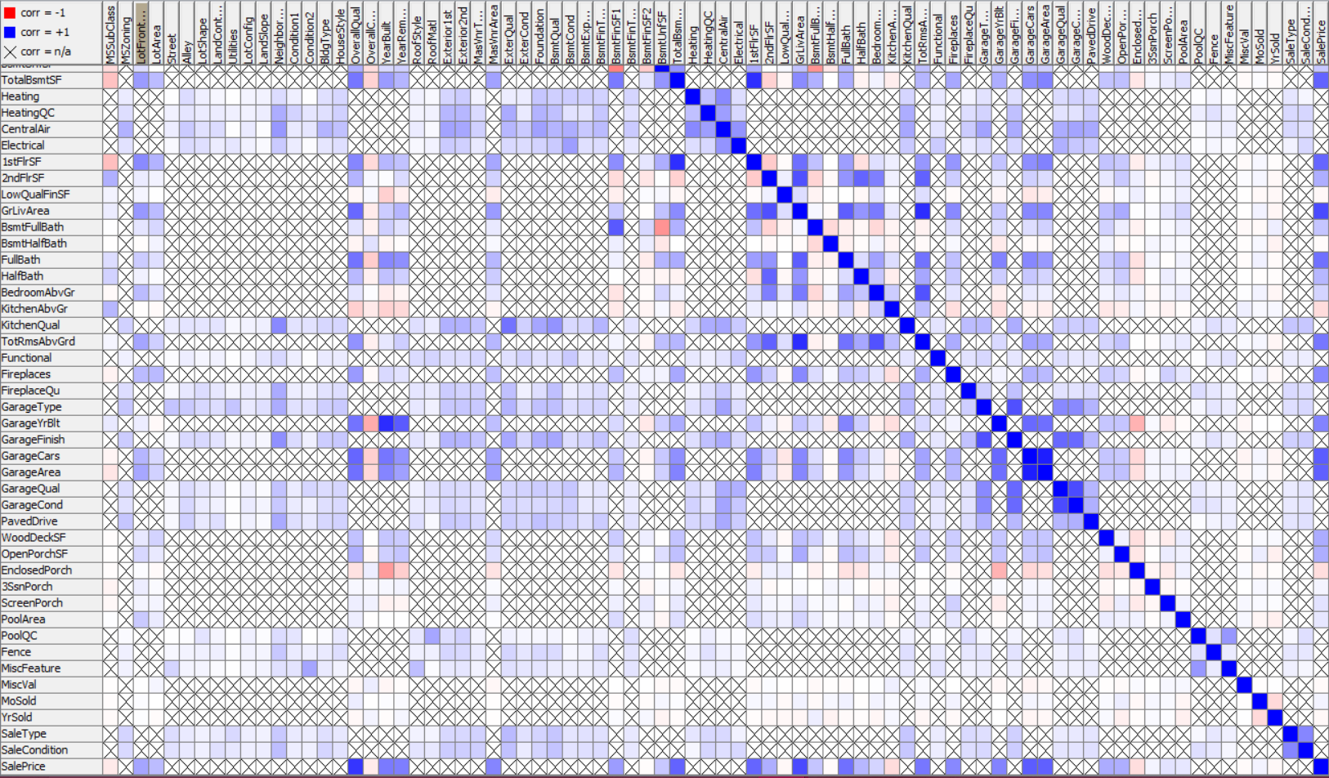
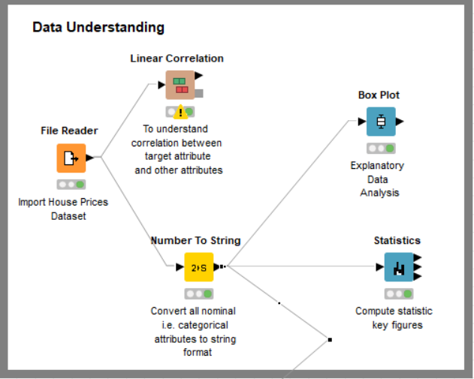
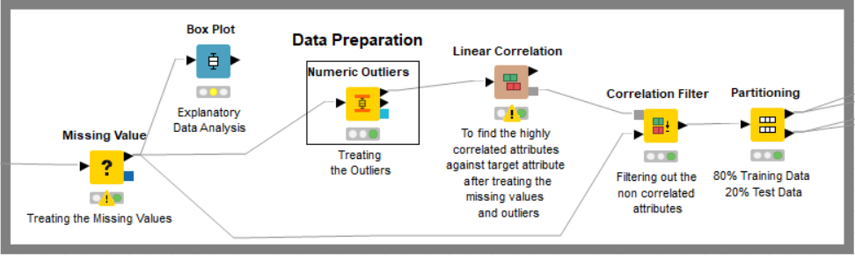
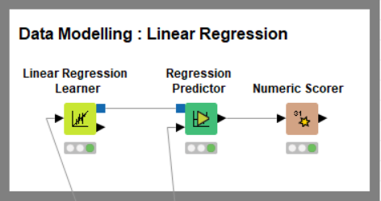
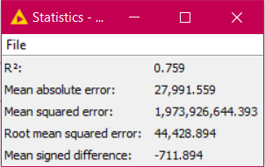
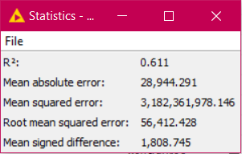
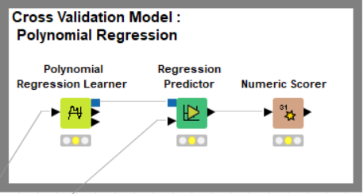
Group 4 : House Prices
Pranavi Burra, Akshatha Wuluvarana Ghanashyam Raj
Challenge
Dataset
Prediction of the final price of each home.
Describes (almost) every aspect of residential homes in Ames.
1460 Records and 80 Attributes
37 Numeric Values and
43 Nominal Values
Data Understanding
Correlation Chart
259 Missing Values in “LotFrontage’ attribute.
8 and 81 Missing Values in ‘MasVnrArea’ and ‘GarageYrBlt’ attributes respectively.
The target attribute i.e., ‘Sales Price’ is Continuous and is highly Correlated with 36 attributes.
The given Dataset comes under Supervised Learning as the labels are specified.
Data Preparation
8 attributes from the total numeric values were changed from Number to String since they were discrete.
Missing Values were treated by Removing the Row for string values and imputing with Mean for integer values.
Outliers were treated by replacing the outliers by the closest permitted values in the Numeric Outlier node.
Linear Correlation was used to filter out the non correlated data.
Modelling
Partioning of data
80% Training set
20% Test set
Since the target attribute is continuous, Regression Models were applied.
Linear and Polynomial Regression Methods are used.
Results
Linear Regression generates the highest probability between the attributes due to high correlation whereas Polynomial Regression with a order of 2 generates the next best results.
Modelling statistics for Linear Regression
Modelling statistics for
Polynomial Regression
Conclusion
Only the attributes that are correlated with respect to the target attribute was considered.
Categorical Attributes even thought were highly correlated were ignored since the target attribute values were continuous.

